Slide 1

Recurrent Neural Networks II
Yao-Yi Chiang
Computer Science and Engineering
University of Minnesota
yaoyi@umn.edu
CC-BY
Attribution

Slide 2
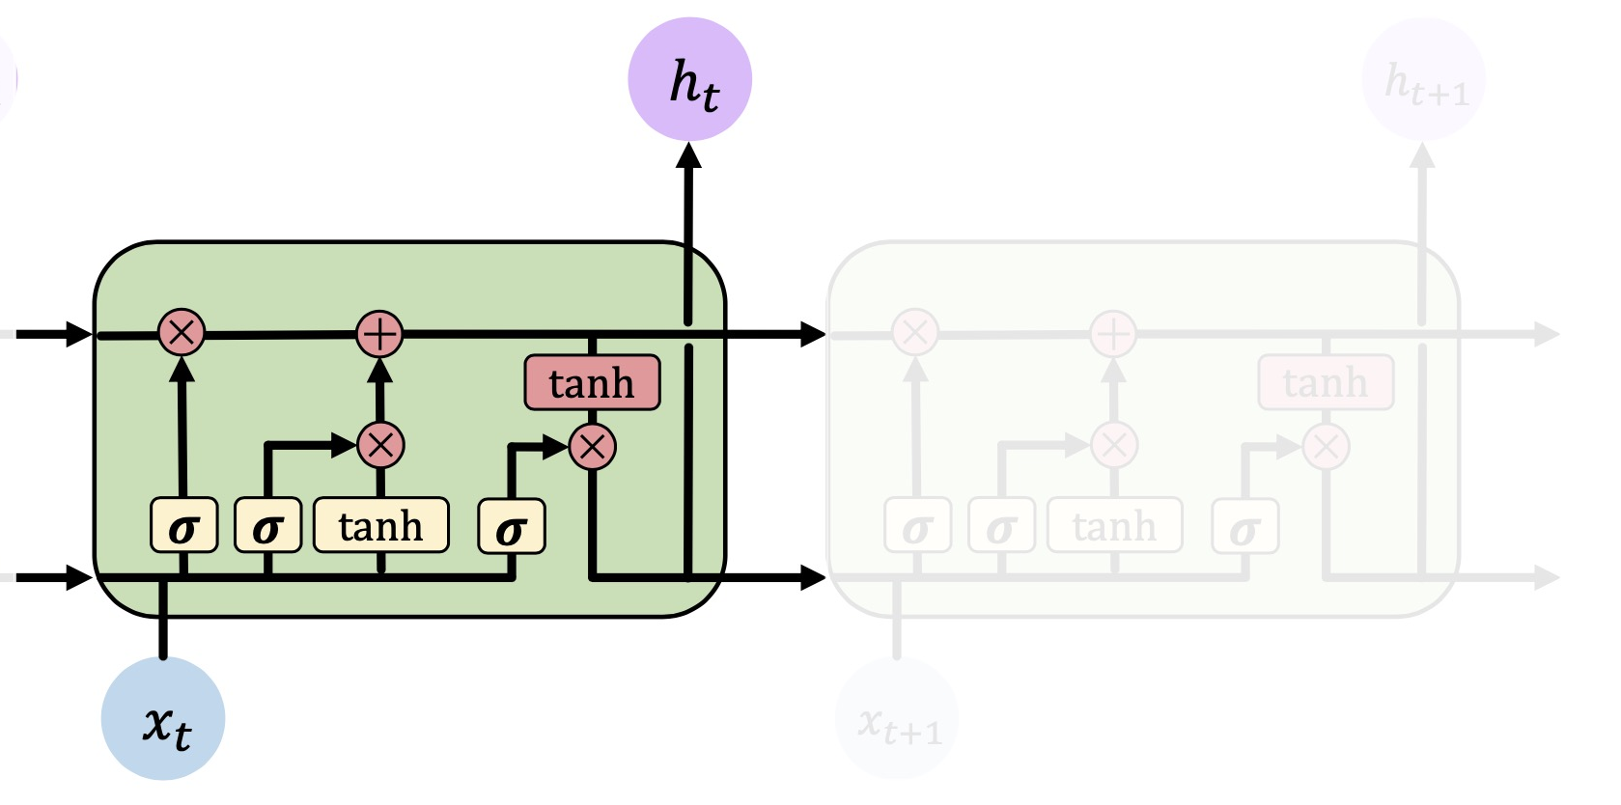
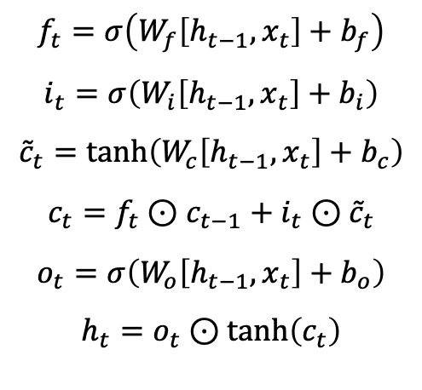
Recall: Long-Short Term Memory
LSTM uses a complex recurrent unit with gates to control what information is passed through that can avoid vanishing gradient problem in standard RNNs
$$f_{t}=σ\left(W_{f}\left[h_{t−1},x_{t}\right]+b_{f}\right)$$
$$i_{t}=σ\left(W_{i}\left[h_{t−1},x_{t}\right]+b_{i}\right)$$
$${\tilde{c}}_{t}=\tanh\left(W_{c}\left[h_{t−1},x_{t}\right]+b_{c}\right)$$
$$c_{t}=f_{t}⊙c_{t−1}+i_{t}{⊙\tilde{c}}_{t}$$
$$o_{t}=σ\left(W_{o}\left[h_{t−1},x_{t}\right]+b_{o}\right)$$
$$h_{t}=o_{t}⊙\tanh\left(c_{t}\right)$$

Slide 3
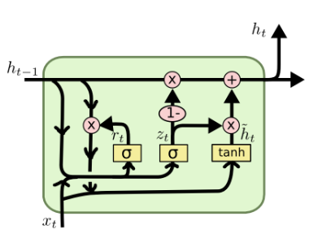
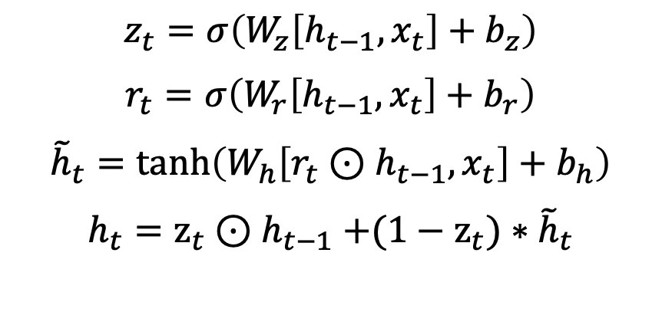
Gated Recurrent Unit (GRU)
GRU is another RNN variant [Cho et al. 2014]
GRU reduces the number of gates but achieves similar performance to LSTM
GRU Cell
$$z_{t}=σ\left(W_{z}\left[h_{t−1},x_{t}\right]+b_{z}\right)$$
$$r_{t}=σ\left(W_{r}\left[h_{t−1},x_{t}\right]+b_{r}\right)$$
$${\tilde{h}}_{t}=\tanh\left(W_{h}\left[r_{t}{⊙h}_{t−1},x_{t}\right]+b_{h}\right)$$
$$h_{t}=z_{t}{⊙h}_{t−1}+(1−z_{t})∗{\tilde{h}}_{t}$$

Slide 4
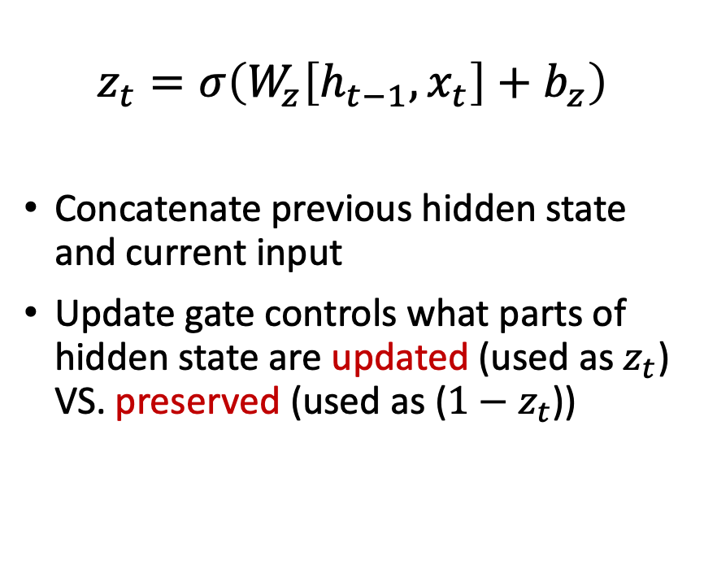
GRU: Update Gate
$$z_{t}=σ\left(W_{z}\left[h_{t−1},x_{t}\right]+b_{z}\right)$$
Concatenate previous hidden state and current input
Update gate controls what parts of hidden state are updated (used as $z_{t}$) VS. preserved (used as (${1−z}_{t}$))
GRU Cell

Slide 5
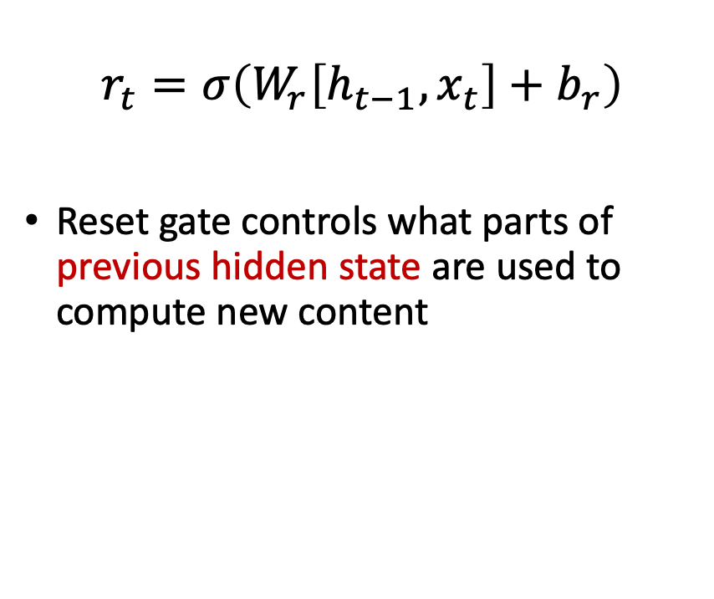
GRU: Reset Gate
$$r_{t}=σ\left(W_{r}\left[h_{t−1},x_{t}\right]+b_{r}\right)$$
Reset gate controls what parts of previous hidden state are used to compute new content
GRU Cell

Slide 6
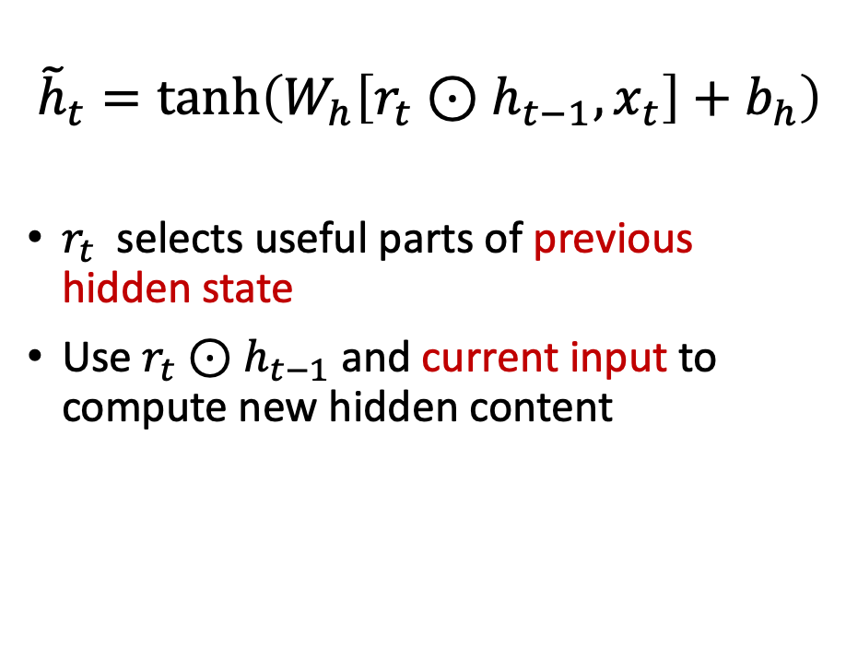
GRU: New Hidden State Content
$${\tilde{h}}_{t}=\tanh\left(W_{h}\left[r_{t}{⊙h}_{t−1},x_{t}\right]+b_{h}\right)$$
$r_{t}$ selects useful parts of previous hidden state
Use $r_{t}{⊙h}_{t−1}$ and current input to compute new hidden content
GRU Cell

Slide 7
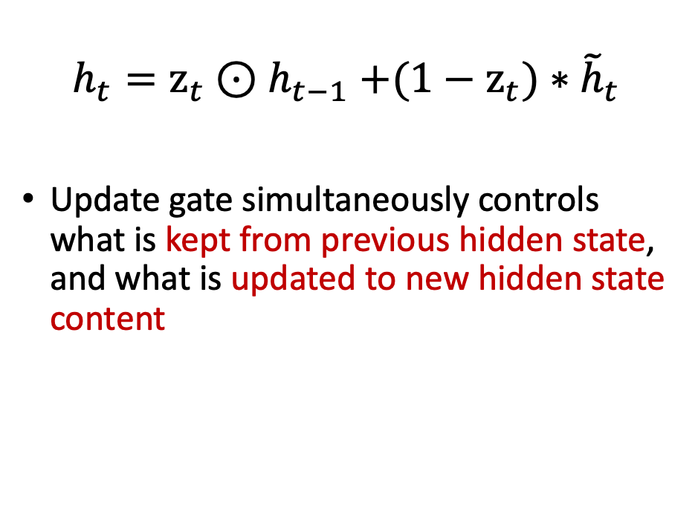
GRU: Output Hidden State
$$h_{t}=z_{t}{⊙h}_{t−1}+(1−z_{t})∗{\tilde{h}}_{t}$$
Update gate simultaneously controls what is kept from previous hidden state, and what is updated to new hidden state content
GRU Cell

Slide 8
GRU VS. LSTM: Which to Use?
In many tasks, both architectures yield comparable performance [1]
Both architectures were proposed to tackle the vanishing gradient problem but using a different way of fusing previous timestep information with gates to prevent from vanishing gradients
Nevertheless, the gradient flow in LSTM comes from three different gates, so intuitively, you would observe more variability in the gradient descent compared to GRUs
[1] Greff, K., Srivastava, R. K., Koutník, J., Steunebrink, B. R., & Schmidhuber, J. (2016). LSTM: A search space odyssey. IEEE transactions on neural networks and learning systems, 28(10), 2222–2232.

Slide 9
GRU VS. LSTM: Which to Use?
GRU has two gates (reset and update gates) whereas an LSTM has three gates (namely input, output, and forget gates)
GRU is considered more efficient in terms of simpler structure with fewer parameters
In small-scale datasets with not too long sequences, it is common to use GRU cells since with fewer data the expressive power of LSTM may not be exposed

Slide 10
GRU VS. LSTM: Which to Use?
If you deal with large datasets, the greater expressive power of LSTMs may lead to superior results
In theory, the LSTM cells should remember longer sequences than GRUs and outperform them in tasks requiring modeling long-range correlations
Which to use lies in the data

Slide 11

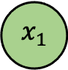
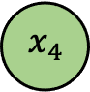
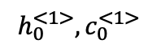
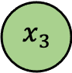
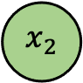
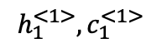
Deep RNN Examples: Stacked LSTMs
$$y$$
An example of “Many to One”
Initialize hidden and cell states for Layer <1>
$$h_{0}^{<1>}, c_{0}^{<1>}$$
LSTM
$$h_{1}^{<1>}, c_{1}^{<1>}$$
LSTM
LSTM
LSTM
Layer <1>
$$x_{1}$$
$$x_{2}$$
$$x_{3}$$
$$x_{4}$$
* LSTM cell can be replaced with other RNN cells

Slide 12
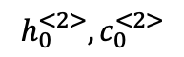
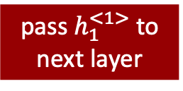
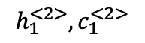
Deep RNN Examples: Stacked LSTMs
$$y$$
An example of “Many to One”
Stack a second LSTM layer
$$h_{0}^{<2>}, c_{0}^{<2>}$$
LSTM
$$h_{1}^{<2>}, c_{1}^{<2>}$$
LSTM
LSTM
LSTM
Layer <2>
pass $h_{1}^{<1>}$ to next layer
$$h_{0}^{<1>}, c_{0}^{<1>}$$
LSTM
$$h_{1}^{<1>}, c_{1}^{<1>}$$
LSTM
LSTM
LSTM
Layer <1>
$$x_{1}$$
$$x_{2}$$
$$x_{3}$$
$$x_{4}$$
* LSTM cell can be replaced with other RNN cells

Slide 13
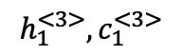
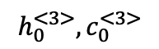
Deep RNN Examples: Stacked LSTMs
Stack more layers and Initialize hidden and cell states for each layer
$$y$$
An example of “Many to One”
$$h_{0}^{<3>}, c_{0}^{<3>}$$
LSTM
$$h_{1}^{<3>}, c_{1}^{<3>}$$
LSTM
LSTM
LSTM
Layer <3>
$$h_{0}^{<2>}, c_{0}^{<2>}$$
LSTM
$$h_{1}^{<2>}, c_{1}^{<2>}$$
LSTM
LSTM
LSTM
Layer <2>
pass $h_{1}^{<1>}$ to next layer
$$h_{0}^{<1>}, c_{0}^{<1>}$$
LSTM
$$h_{1}^{<1>}, c_{1}^{<1>}$$
LSTM
LSTM
LSTM
Layer <1>
$$x_{1}$$
$$x_{2}$$
$$x_{3}$$
$$x_{4}$$
* LSTM cell can be replaced with other RNN cells

Slide 14
Stacked LSTMs
Staked LSTMs were first introduced in [1] for speech recognition
They also found that the depth of the network was more important than the number of memory cells in a layer to model skill
Why increasing depth?
Given that Stacked LSTMs operate on sequence data, the addition of layers adds levels of abstraction of input observations over time
Other domains
Traffic forecast [2], weather forecast [3]
[1] Graves, A., Mohamed, A. R., & Hinton, G. Speech recognition with deep recurrent neural networks. In 2013 IEEE international conference on acoustics, speech and signal processing (pp. 6645-6649).
[2] Du, X., Zhang, H., Van Nguyen, H., & Han, Z. Stacked LSTM deep learning model for traffic prediction in vehicle-to-vehicle communication. In 2017 IEEE 86th Vehicular Technology Conference (pp. 1-5).
[3] Karevan, Z., & Suykens, J. A. (2018). Spatio-temporal stacked LSTM for temperature prediction in weather forecasting. arXiv preprint arXiv:1811.06341.

Slide 15
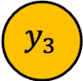
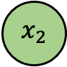
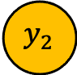
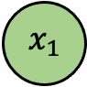
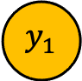
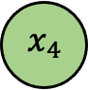
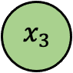
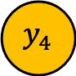
Deep RNN Examples: Bidirectional LSTM
Regular LSTM considers forward direction, i.e., past to future
$${ y}_{1}$$
$${ y}_{2}$$
$${ y}_{3}$$
$${ y}_{4}$$
An example of “Many to Many”
Output Layer
Forward Layer
LSTM
LSTM
LSTM
LSTM
$$x_{1}$$
$$x_{2}$$
$$x_{3}$$
$$x_{4}$$

Slide 16
Bidirectional LSTM Example
Name Entity Recognition
person
fruit
Yao loves apple , it keeps me healthy
person
company
Yao loves apple , it produces the best electronics

Slide 17
Bidirectional LSTM Example
Name Entity Recognition
Regular LSTM networks might not work
person
fruit
Yao loves apple , it keeps me healthy
fruit
or
company
LSTM
LSTM
LSTM
LSTM
LSTM
LSTM
LSTM
Yao
loves
apple
it
keeps
me
healthy

Slide 18
Bidirectional LSTM
Bidirectional LSTM considers the sequence information in both directions backwards (future to past) and forward (past to future)
$${ y}_{1}$$
$${ y}_{2}$$
$${ y}_{3}$$
$${ y}_{4}$$
An example of “Many to Many”
Output Layer
Activation Layer
Backward Layer
LSTM
LSTM
LSTM
LSTM
Forward Layer
LSTM
LSTM
LSTM
LSTM
$$x_{1}$$
$$x_{2}$$
$$x_{3}$$
$$x_{4}$$

Slide 19
Bidirectional LSTM Example
Name Entity Recognition
Red arrows are the information flow
fruit
LSTM
LSTM
LSTM
LSTM
LSTM
LSTM
LSTM
LSTM
LSTM
LSTM
LSTM
LSTM
LSTM
LSTM
Yao
loves
apple
it
keeps
me
healthy

Slide 20
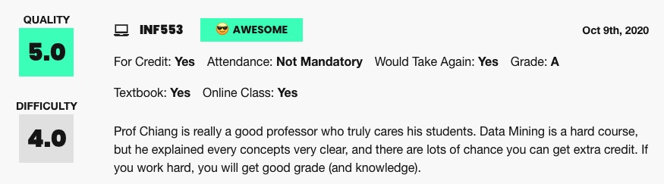
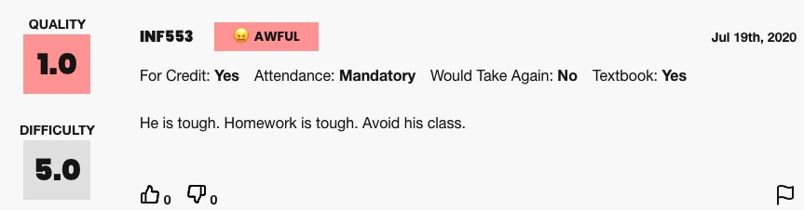
RNN Applications: Sentiment Classification
Ratemyprofessors Sentiment Classification
Source: https://www.ratemyprofessors.com/ShowRatings.jsp?tid=2391740

Slide 21
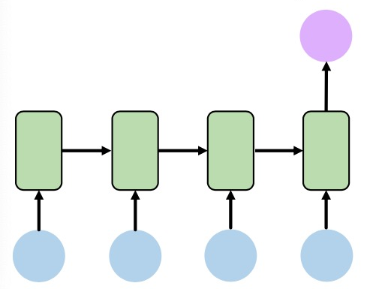
RNN Applications: Sentiment Classification
Ratemyprofessors Sentiment Classification
Sentiment
<positive>
I
love
this
class
Source: https://www.ratemyprofessors.com/ShowRatings.jsp?tid=2391740

Slide 22
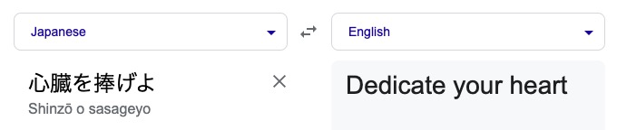

RNN Applications: Machine Translation
Attack on Titan, Source: https://www.youtube.com/watch?v=BhipGqSZEB0

Slide 23
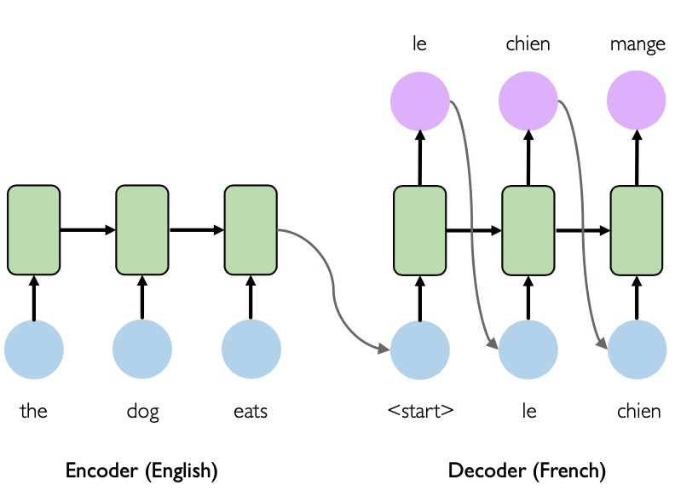
RNN Applications: Machine Translation
Dedicate
your
heart
Sequence-to-sequence [1]
(Seq2Seq)
心
臓
を
捧
げ
よ
<start>
Dedicate
your
Encoder (Japanese)
Decoder (English)
[1] Sutskever, I., Vinyals, O., & Le, Q. V. (2014). Sequence to sequence learning with neural networks. Advances in neural information processing systems, 27.

Slide 24
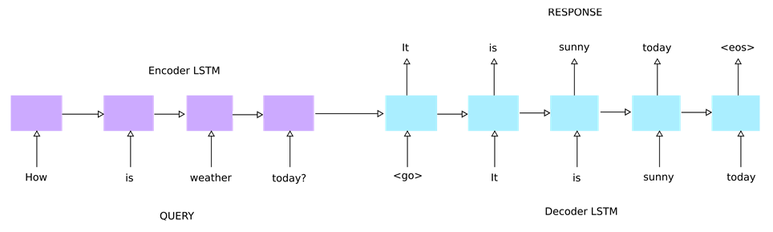
Sequence-to-Sequence Learning (Seq2Seq)
Seq2Seq is to train models that convert sequences from one domain (e.g., sentences in Japanese) to sequences in another domain (e.g., the same sentences translated to English)
Input sequences and output sequences can have different lengths (e.g., machine translation, chatbot)
Source: https://www.oreilly.com/library/view/deep-learning-essentials/9781785880360/b71e37fb-5fd9-4094-98c8-04130d5f0771.xhtml

Slide 25
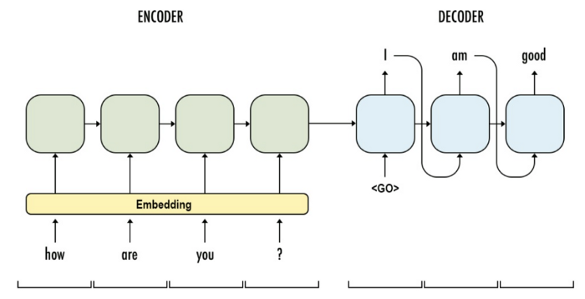
Seq2Seq
The encoder transforms an input sequence of variable length into a fixed-shape context variable (e.g., hidden and cell states in LSTM)
Source: https://medium.com/analytics-vidhya/intuitive-understanding-of-seq2seq-model-attention-mechanism-in-deep-learning-1c1c24aace1e

Slide 26
Seq2Seq
The decoder model is trained to predict the next word in the sequence given the previous word
Pass <Go> token to indicate the start of prediction
Source: https://medium.com/analytics-vidhya/intuitive-understanding-of-seq2seq-model-attention-mechanism-in-deep-learning-1c1c24aace1e

Slide 27
Limitations of Seq2Seq I
At the early stages of training, the predictions of the decoder are very bad
The hidden states of the model will be updated by a sequence of wrong predictions, and errors will accumulate
Solution: Teacher Forcing
Feed with prediction from last step

Slide 28
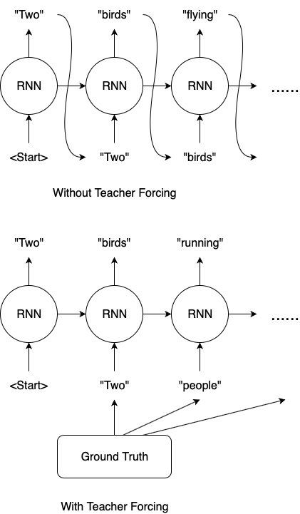
Teacher Forcing
Teacher forcing is a strategy for training recurrent neural networks that uses ground truth as input, instead of model output from a prior time step as an input
Assuming the ground truth sentence is “Two people running …”. Left figure: without Teacher Forcing, the model keeps feeding wrong word after making one mistake. Right figure: with Teacher Forcing, our model feeds “people” for the 3rd prediction.

Slide 29
Pros and Cons of Teacher Forcing
Pros
Training with Teacher Forcing converges faster
Teacher Forcing can prevent error accumulation during training
Cons
During inference, since there is no ground truth available, the RNN model will need to feed its own previous prediction for the next prediction
There is a discrepancy between training and inference, and might lead to poor model performance and instability

Slide 30

Curriculum Learning
The curriculum learning is to randomly choose to use the ground truth output or the generated output from the previous time step as the input for the current time step
The curriculum learning encourages the model to learn how to correct its own mistakes
Flip a coin to decide to use the true previous token or predicted token from the model

Slide 31
Scheduled Sampling
The curriculum changes over time is called scheduled sampling [1]
The scheduled sampling changes the training process from a fully guided scheme using the true previous token, towards a less guided scheme which mostly uses the generated token instead
For example, at the beginning of the training process, using Teacher Forcing. After several epochs, using the prediction as the input.
[1] Bengio, S., Vinyals, O., Jaitly, N., & Shazeer, N. (2015). Scheduled sampling for sequence prediction with recurrent neural networks. Advances in neural information processing systems, 28.

Slide 32
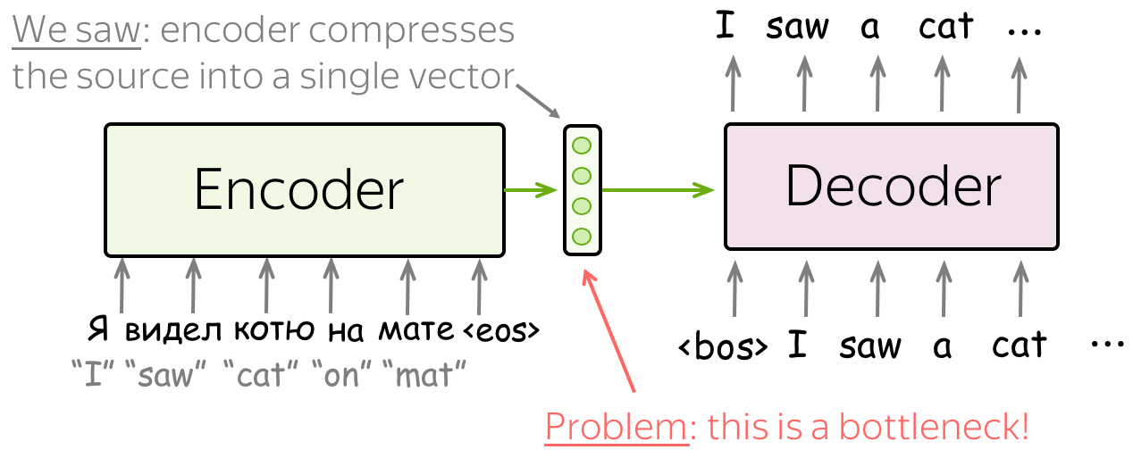
Limitations of Seq2Seq II
The encoder and decoder works fine for short sequence
However, when the sequence is long, the encoder might be difficult to memorize the entire sequence into a fixed-sized vector and to compress all the contextual information in the sequence
Solution: Attention
Source: https://lena-voita.github.io/nlp_course/seq2seq_and_attention.html

Slide 33
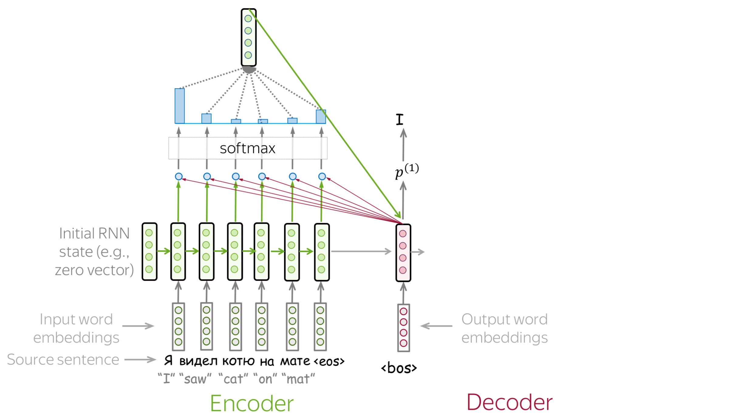
Attention in Seq2Seq
Let the model "focus" on different parts of the output from encoder
Source: https://lena-voita.github.io/nlp_course/seq2seq_and_attention.html

Slide 34
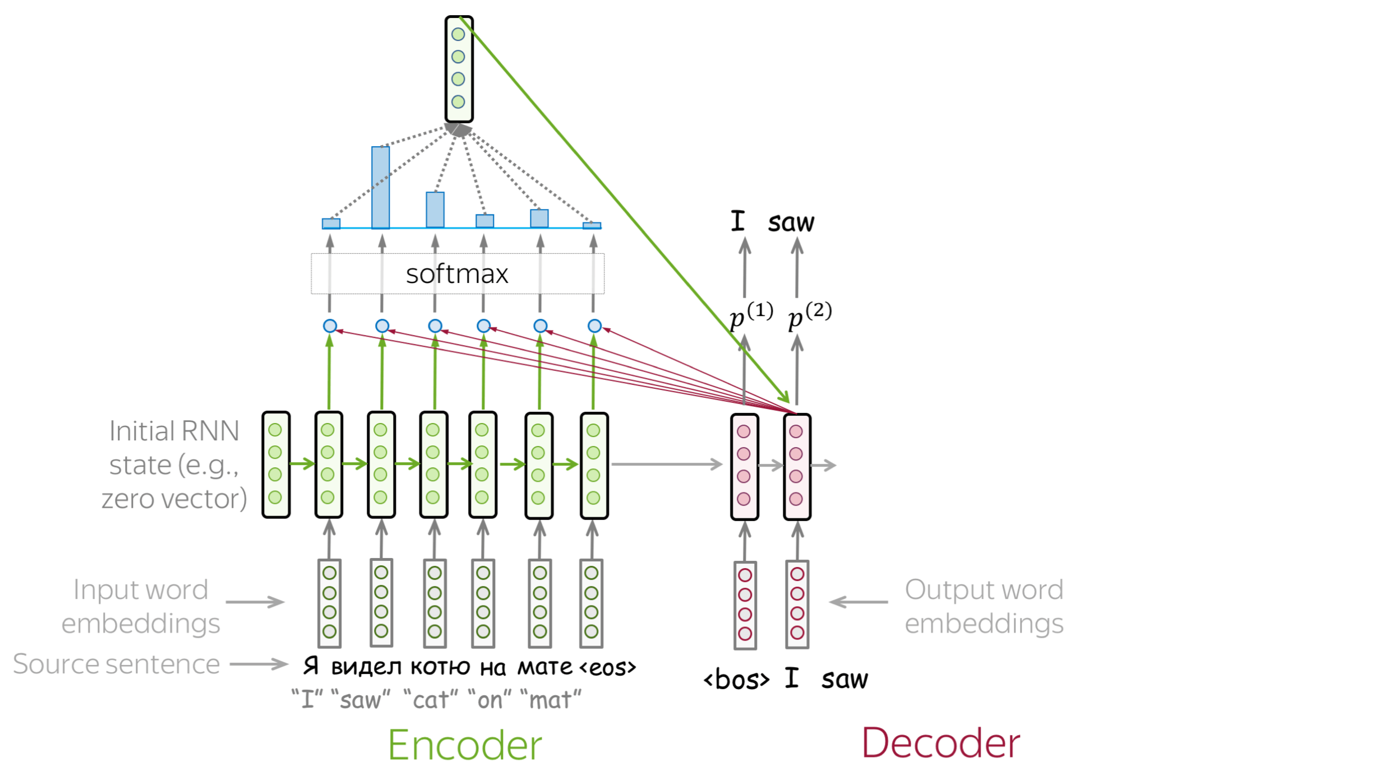
Attention in Seq2Seq
Let the model "focus" on different parts of the output from encoder
Source: https://lena-voita.github.io/nlp_course/seq2seq_and_attention.html

Slide 35
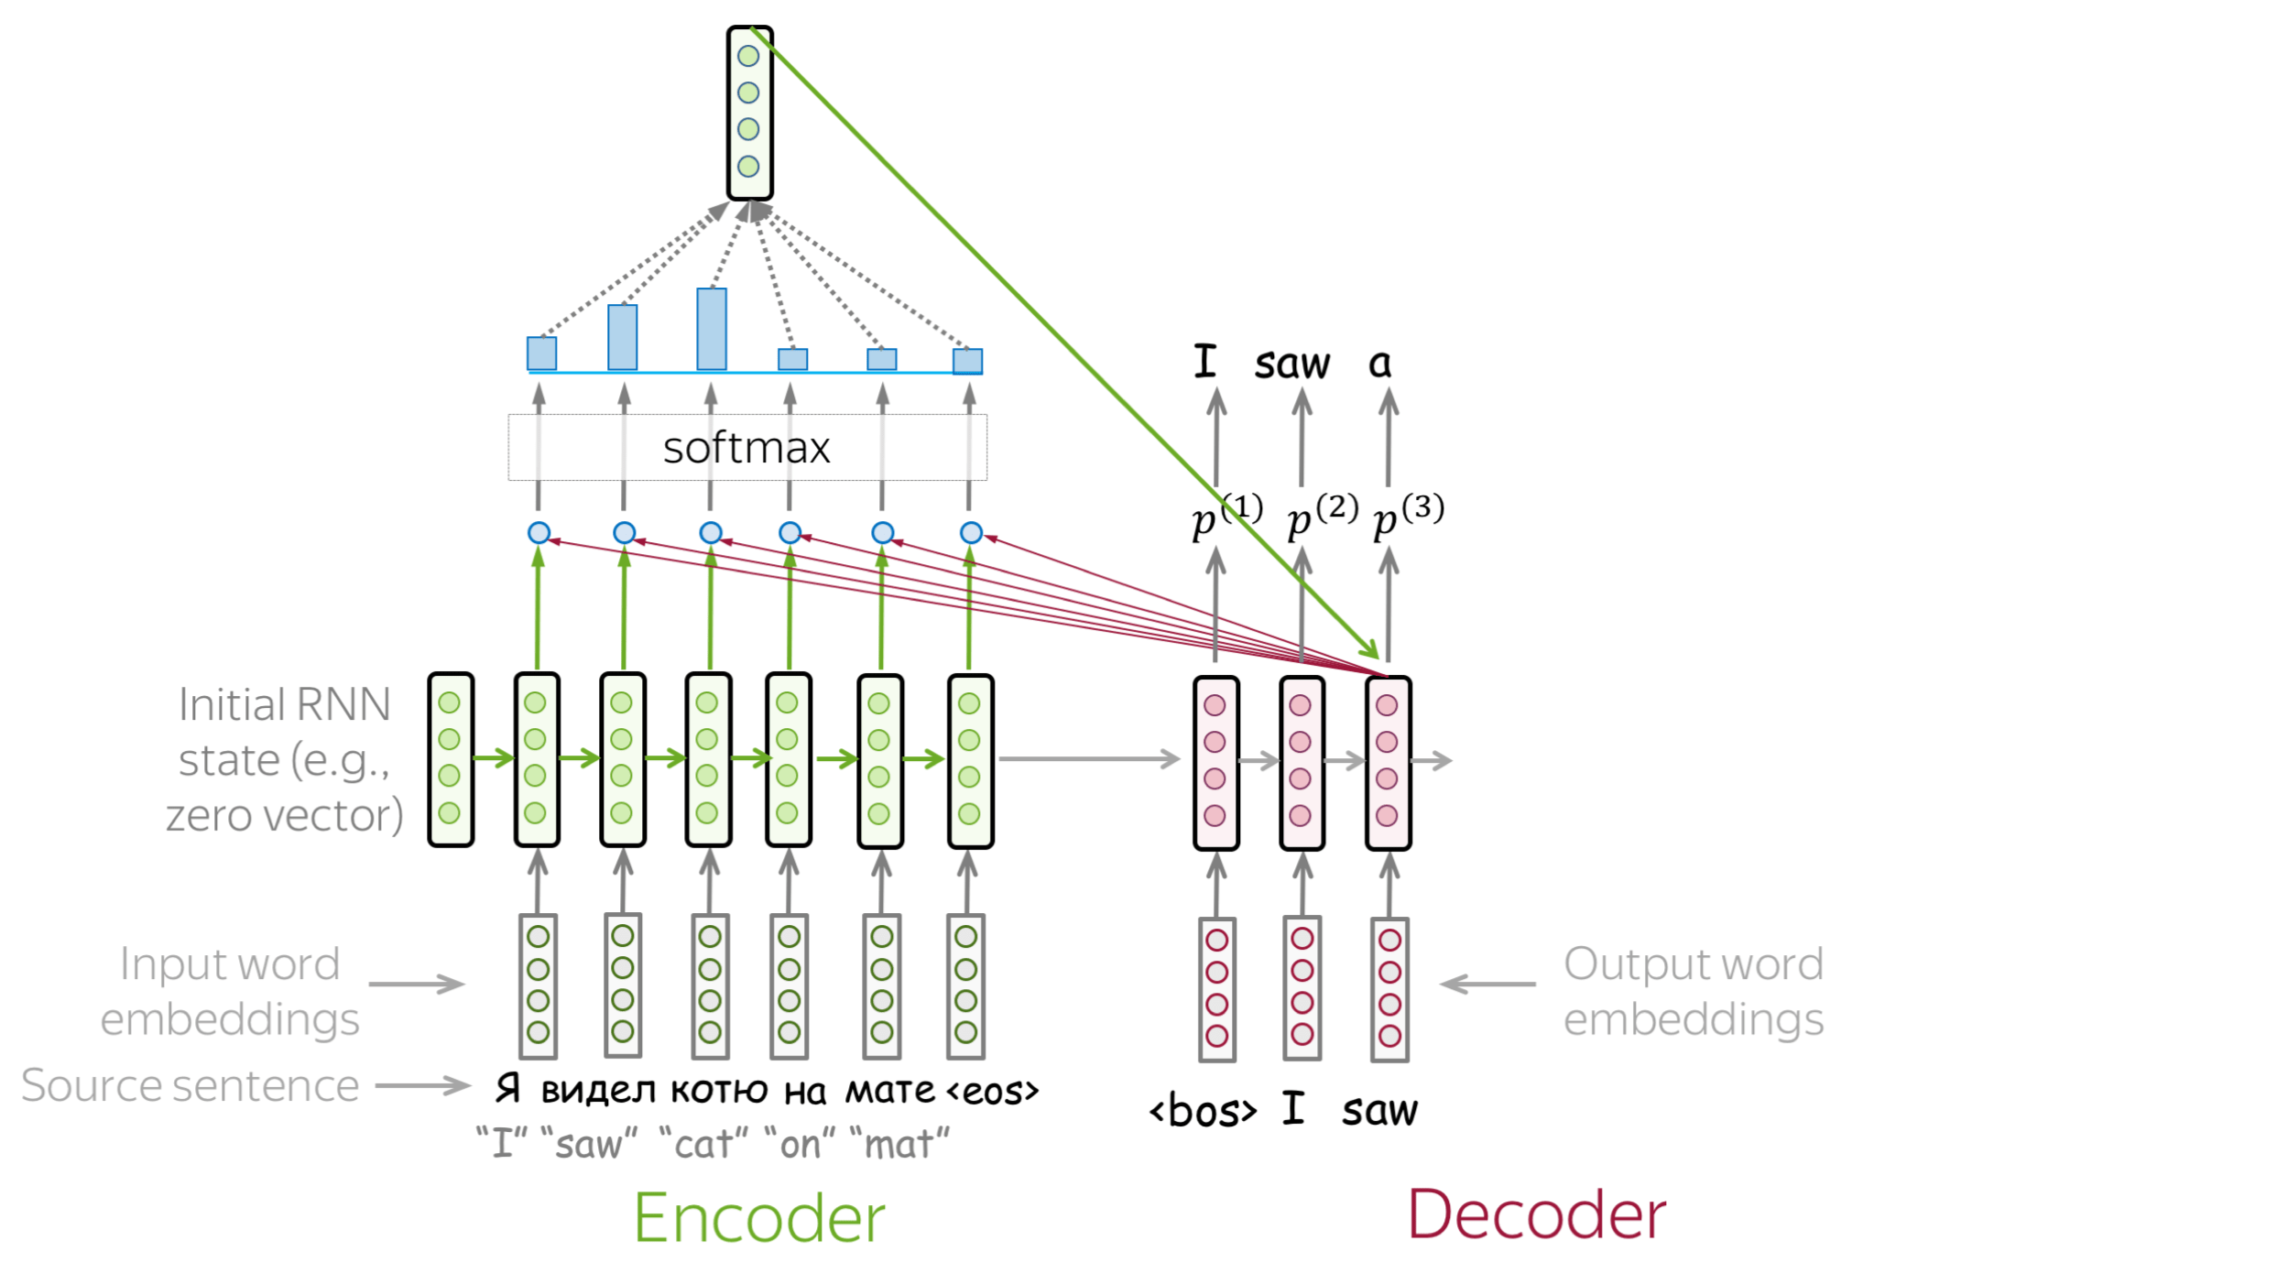
Attention in Seq2Seq
Let the model "focus" on different parts of the output from encoder
Source: https://lena-voita.github.io/nlp_course/seq2seq_and_attention.html

Slide 36
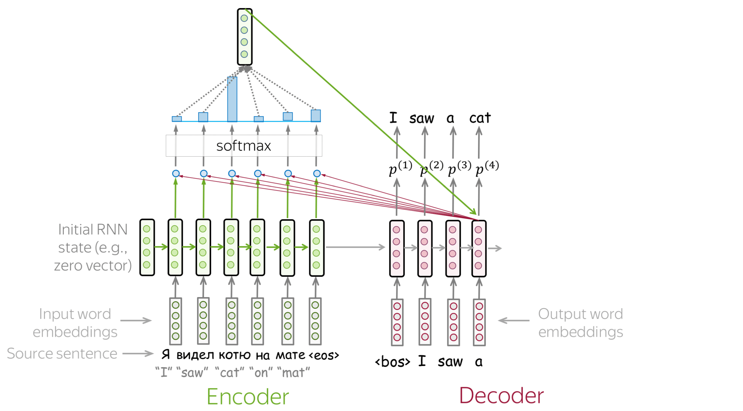
Attention in Seq2Seq
Let the model "focus" on different parts of the output from encoder
Source: https://lena-voita.github.io/nlp_course/seq2seq_and_attention.html

Slide 37
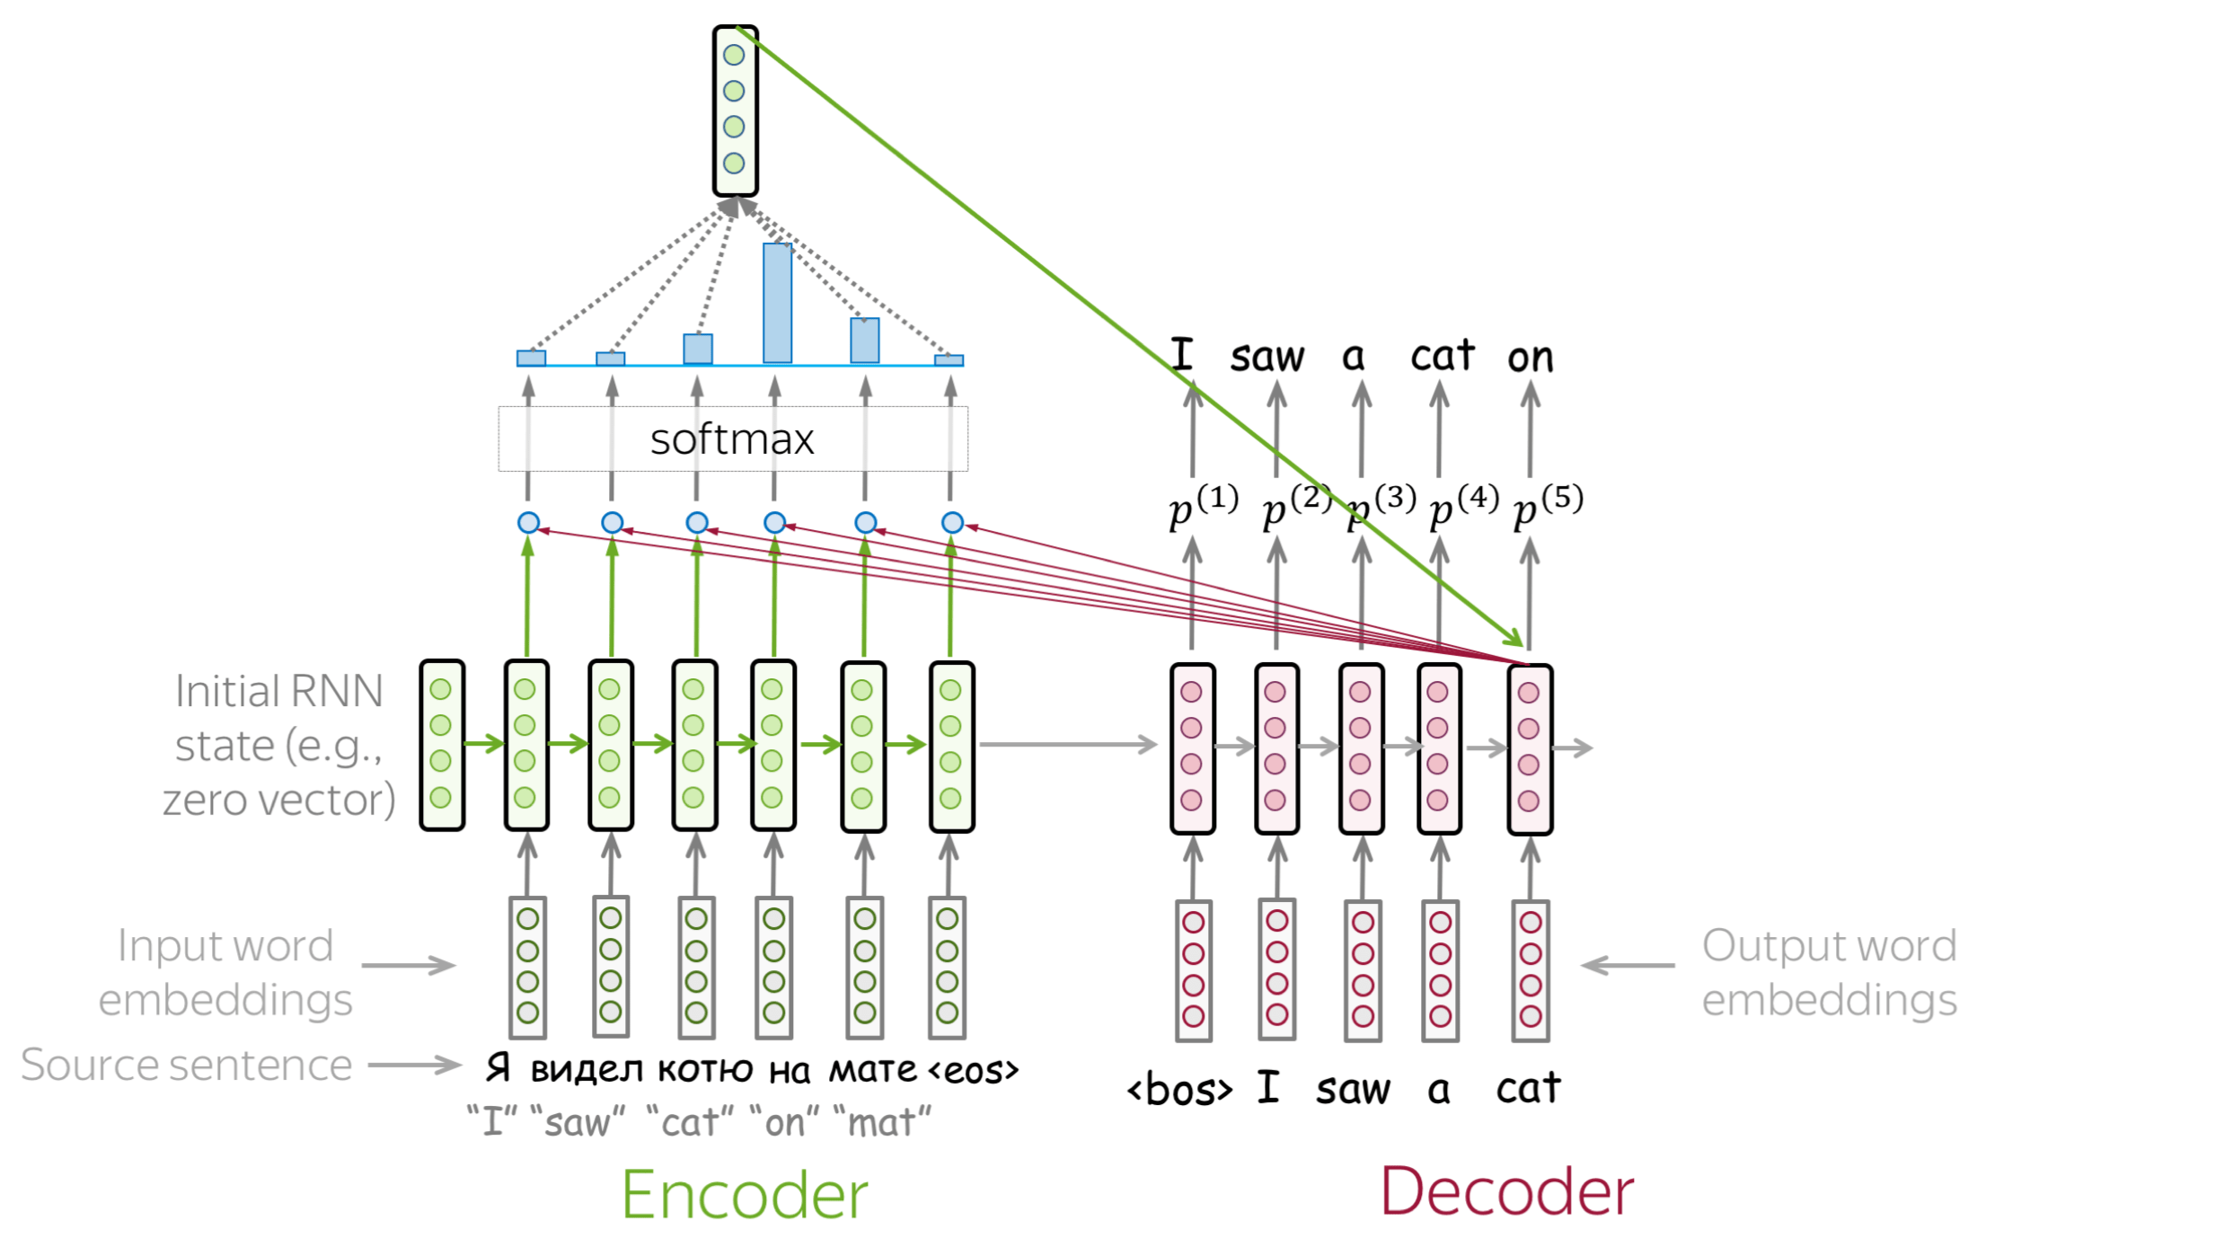
Attention in Seq2Seq
Let the model "focus" on different parts of the output from encoder
Source: https://lena-voita.github.io/nlp_course/seq2seq_and_attention.html

Slide 38
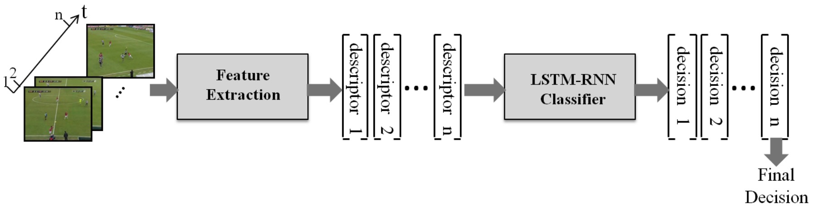
More than Language Models RNN in Sports
Sport is a sequence of event (e.g., sequence of images, voices)
Applying RNN to basketball trajectories in the form of sequence modeling to predict whether a three-point shot is successful [1]
Action Classification in Soccer Videos with Long Short-Term Memory Recurrent Neural Networks [2]
[1] Shah, Rajiv, and Rob Romijnders. "Applying Deep Learning to Basketball Trajectories." arXiv preprint arXiv:1608.03793 (2016).
[2] Baccouche, Moez, et al. "Action classification in soccer videos with long short-term memory recurrent neural networks." International Conference on Artificial Neural Networks. Springer Berlin Heidelberg, 2010. (The Image is taken from the paper)

Slide 39
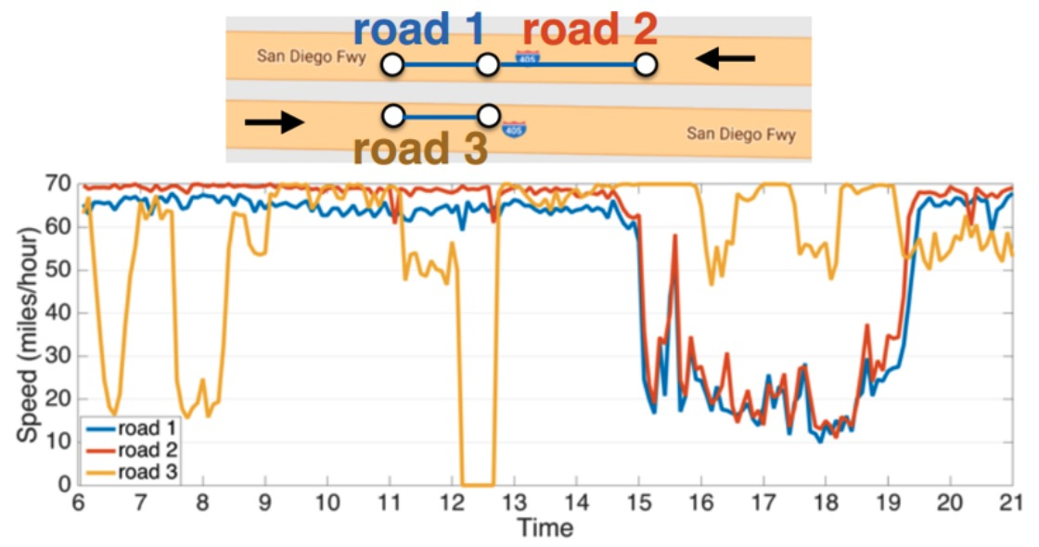
More than Language Model Traffic Forecasting
Traffic forecasting is to predict the future traffic speeds of a sensor network given historic traffic speeds and the underlying road networks
[1] Li, Y., Yu, R., Shahabi, C., & Liu, Y. (2017). Diffusion convolutional recurrent neural network: Data-driven traffic forecasting. arXiv preprint arXiv:1707.01926. Images are taken from the paper.

Slide 40
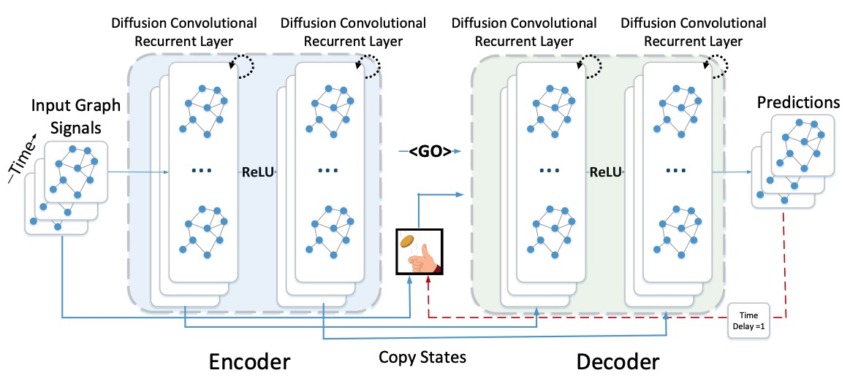
Traffic Forecasting
The paper [1] constructs the sensor network as a graph and embeds graph in the RNN model to capture spatiotemporal evolution
[1] Li, Y., Yu, R., Shahabi, C., & Liu, Y. (2017). Diffusion convolutional recurrent neural network: Data-driven traffic forecasting. arXiv preprint arXiv:1707.01926. Images are taken from the paper.

Slide 41

Summary
GRU is another RNN variant
Stacked RNN and bidirectional RNN are useful RNN architectures
Teaching forcing and curriculum learning strategies accelerate the training process and improve the overall performance
RNNs have been applied in various domains and applications combined with other techniques
Convolution Neural Networks -> ConvLSTM
Graph convolution
Attention

Slide 42
Acknowledgements
Deep learning slides adapted from https://m2dsupsdlclass.github.io/lectures-labs/ by Olivier Grisel and Charles Ollion (CC-By 4.0 license)
Gil, Yolanda (Ed.) Introduction to Computational Thinking and Data Science. Available from http://www.datascience4all.org
https://lilianweng.github.io/posts/2018-08-12-vae/
https://towardsdatascience.com/rnn-cells-analyzing-gru-equations-vs-lstm-and-when-to-choose-rnn-over-transformers-a28e46beef31
https://lena-voita.github.io/nlp_course/seq2seq_and_attention.html

Slide 43

These materials are released under a CC-BY License
https://creativecommons.org/licenses/by/2.0/
You are free to:
Share — copy and redistribute the material in any medium or format
Adapt — remix, transform, and build upon the material
for any purpose, even commercially.
The licensor cannot revoke these freedoms as long as you follow the license terms.
Under the following terms:
Attribution — You must give appropriate credit, provide a link to the license,
and indicate if changes were made. You may do so in any reasonable manner,
but not in any way that suggests the licensor endorses you or your use.
Artwork taken from other sources is acknowledged where it appears.
Artwork that is not acknowledged is by the author.
Please credit as: Chiang, Yao-Yi Introduction to Spatial Artificial Intelligence. Available from https://yaoyichi.github.io/spatial-ai.html
If you use an individual slide, please place the following at the bottom: “Credit: https://yaoyichi.github.io/spatial-ai.html
We welcome your feedback and contributions.
Credit: http://www.datascience4all.org/

